Slide 1
model_training.py
model_training.py - predict the price per kilo of a boxed tea.
Workflow (the standard hold-out + cross-validation scheme):
1. Split the data ONCE: 80% "train" and 20% "test". The split keeps all variants of a product together and is
stratified by price band, so the few extreme products are spread fairly between the two parts.
2. On the 80% train part run 5-fold cross-validation (each fold: 80% of it to fit, 20% to check). This is where
models are compared and chosen. The 20% test part is not used here.
3. Fit the chosen model on the whole 80% and score it ONCE on the 20% test part. No changes after that.
4. Refit the chosen model on ALL rows and save it - that is the model you use in production.
Metrics: R2 (log and EUR/kg), MAE, RMSE, median and mean % error, RMSLE - each next to two naive baselines
("always predict the shop's median price per kilo" and "always predict the overall median").
Model: price per kilo is learned on a log scale (the range is 36 - 8970 EUR/kg), from company, weight, tea type,
origin and name keywords; one scikit-learn pipeline, so the saved file takes the raw columns and returns EUR/kg.

Slide 2
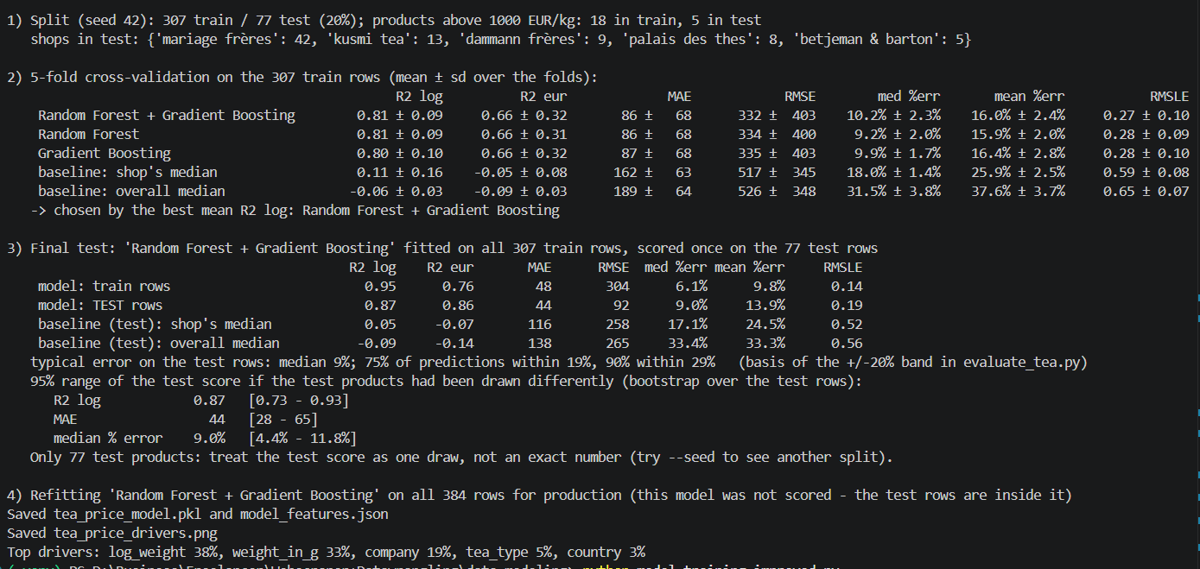
model_training.py
Random forest + Gradient Boosting get best score

Slide 3
model_training_modified.py
model_training.py - predict the intrinsic price per kilo of a boxed tea.
Workflow: Filtered to standard ~100g packages to remove packaging markup bias.
CRITICAL FIX:
REMOVED: "weight_in_g" and "log_weight" so the model cannot cheat using package size.
Filter to standard ~100g packages （80g to 130g)
# This removes the "packaging markup" bias of 30g or 160g boxes

Slide 4
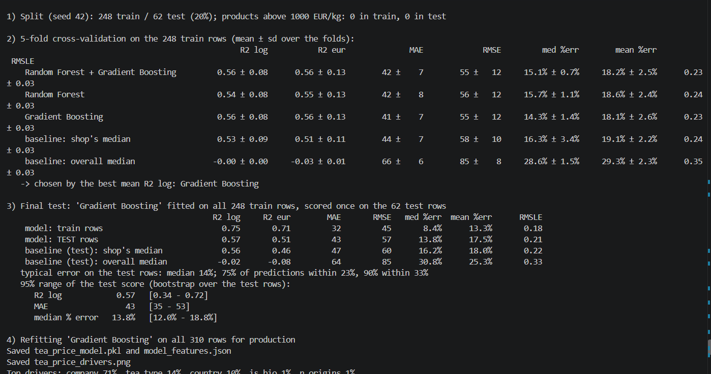
model_training_modified.py
Gradient Boosting get best score

Slide 5
Summary of Model Findings & Insights
1. The Packaging Bias & Matcha Flaw
The Problem: Initially, when weight (weight_in_g and log_weight) was included as a feature, the model gave inaccurate predictions for specialty items like matcha.
The "Cheating" Mechanism: Because high-grade matcha is almost exclusively sold in small 30g tins at premium prices, the model learned a false shortcut: “smaller weight equals a higher price-per-kilo.” Instead of looking at the actual quality of the tea, the model was using the physical container size to predict price.

Slide 6
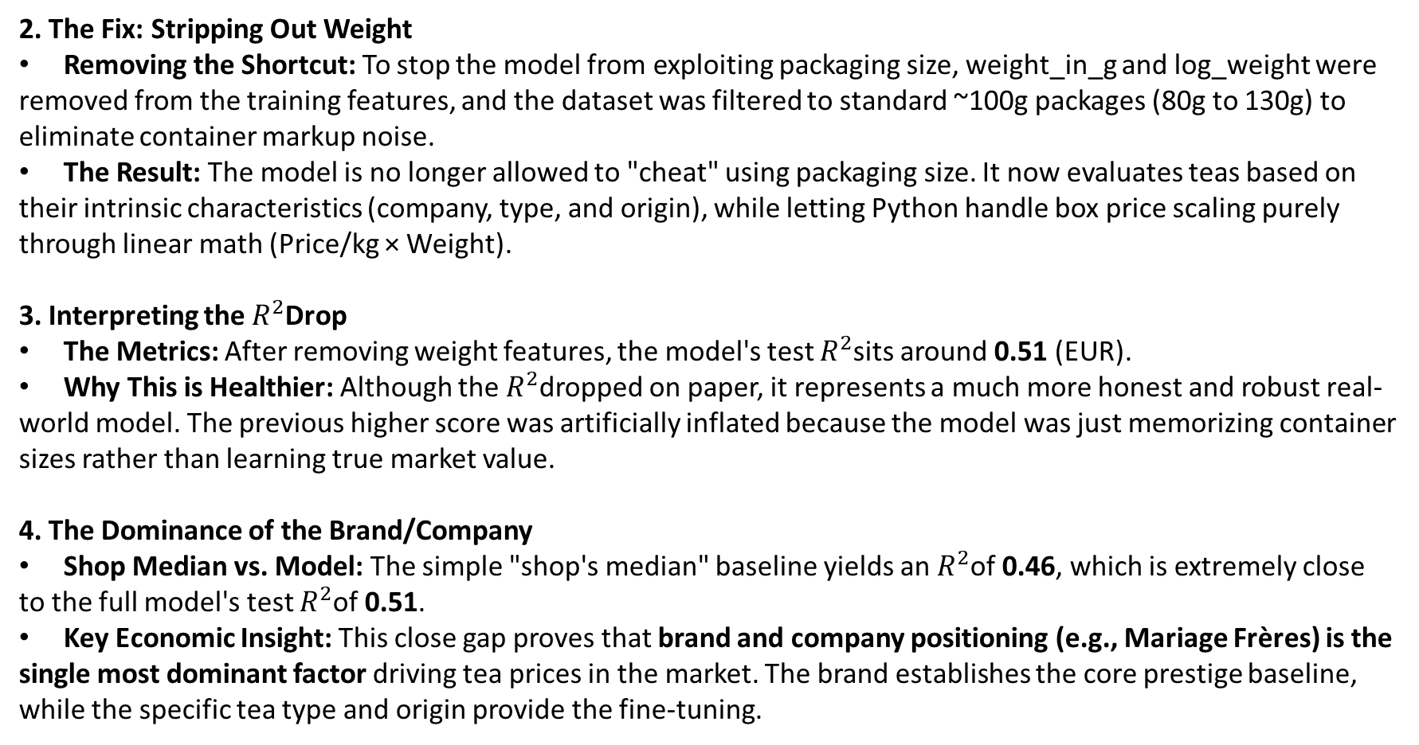
2. The Fix: Stripping Out Weight
Removing the Shortcut: To stop the model from exploiting packaging size, weight_in_g and log_weight were removed from the training features, and the dataset was filtered to standard ~100g packages (80g to 130g) to eliminate container markup noise.
The Result: The model is no longer allowed to "cheat" using packaging size. It now evaluates teas based on their intrinsic characteristics (company, type, and origin), while letting Python handle box price scaling purely through linear math (Price/kg × Weight).
3. Interpreting the $R^{2}$Drop
The Metrics: After removing weight features, the model's test $R^{2}$sits around 0.51 (EUR).
Why This is Healthier: Although the $R^{2}$dropped on paper, it represents a much more honest and robust real-world model. The previous higher score was artificially inflated because the model was just memorizing container sizes rather than learning true market value.
4. The Dominance of the Brand/Company
Shop Median vs. Model: The simple "shop's median" baseline yields an $R^{2}$of 0.46, which is extremely close to the full model's test $R^{2}$of 0.51.
Key Economic Insight: This close gap proves that brand and company positioning (e.g., Mariage Frères) is the single most dominant factor driving tea prices in the market. The brand establishes the core prestige baseline, while the specific tea type and origin provide the fine-tuning.

Slide 7
model_training_improved.py
In the 2-stage machine learning pipeline, Stage 1 (the SVM Tier Classifier) serves as the semantic brain of the model. While Stage 2 looks at the broader numbers and shop categories, Stage 1 focuses entirely on understanding what kind of product it is based on its name and metadata.
Here is specifically what Stage 1 contributes to the pipeline:
1. Unlocks Text Intelligence (TF-IDF + SVM)
Machine learning regression models cannot read product names like "Uji Matcha Ceremonial Grand Cru" directly.
Stage 1 uses TF-IDF to scan the product name for luxury or discount keywords.
The SVM (Support Vector Machine) classifier learns which combinations of words and characters strongly correlate with high-end vs. everyday pricing.
2. Provides Nuanced Confidence Probabilities (p_tier)
Stage 1 does not just output a rigid label (e.g., "This is Luxury"). Instead, it outputs a probability distribution across all four tiers (Discount, Normal, Premium, Luxury).
For example, it might predict: 80% Luxury, 18% Premium, 2% Normal, 0% Discount.
Passing these probability scores into Stage 2 gives the final price regressor a nuanced "confidence signal" rather than a blunt category tag.
3. Solves the Within-Shop Pricing Problem
As you noticed earlier, a shop's median price accounts for ~46% of variance, but it struggles to tell the difference between a cheap €15 everyday black tea and an expensive €300 rare ceremonial matcha sold at the exact same shop.
Stage 2： Same as in other models: random forest + gradient boosting

Slide 8
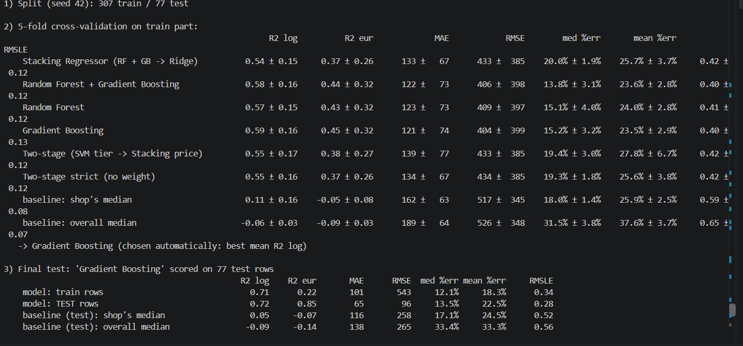
model_training_improved.py
Gradient Boosting get best score
Filter to standard ~100g packages (80g to 130g) is not applied in this version

Slide 9
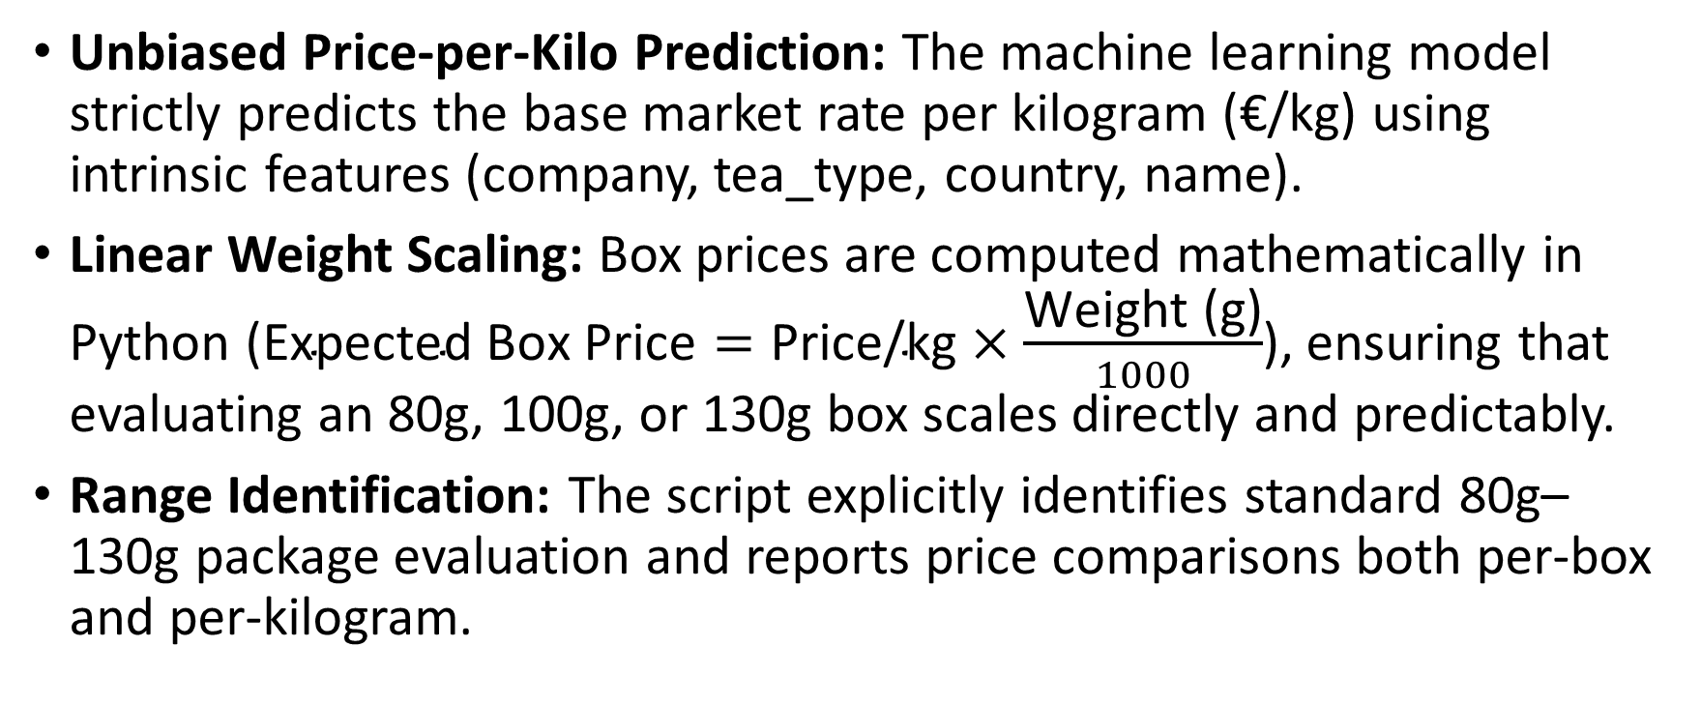
tea_evaluator.py
Unbiased Price-per-Kilo Prediction: The machine learning model strictly predicts the base market rate per kilogram (€/kg) using intrinsic features (company, tea_type, country, name).
Linear Weight Scaling: Box prices are computed mathematically in Python ($\text{Expected Box Price}=\text{Price/kg}×\frac{\text{Weight (g)}}{1000}$), ensuring that evaluating an 80g, 100g, or 130g box scales directly and predictably.
Range Identification: The script explicitly identifies standard 80g–130g package evaluation and reports price comparisons both per-box and per-kilogram.

